Slide 1


Slide 2
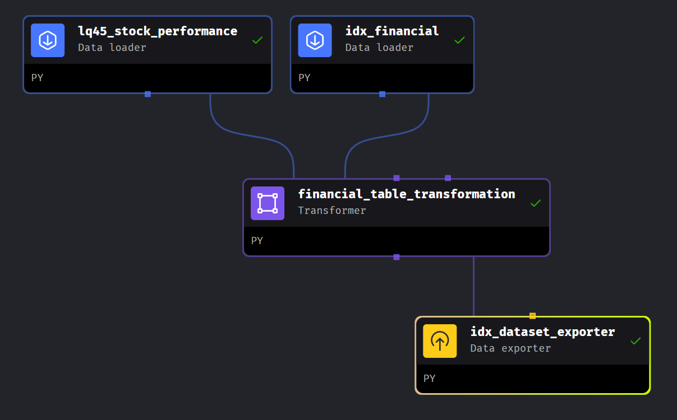

Slide 3
dataset
Income Statement
Total Revenue
Net Income
Net Margin %
Balance Sheet
Total Assets
Total Liabilities
Liabilities to Assets %
Cash Flow
Operating Cash Flow / Cash Flow (contains Operating)
Investing Cash Flow
Financing Cash Flow

Slide 4
Questions
Question: Which companies have the highest total assets in the balance sheet?
Question: List the top 5 companies that had the highest net income margin percentage in the latest available year
List the companies with bad debt ratio (liabilites to asset >60%) on 2023
Question: List the average PE ratio and dividend yield for companies in each sector.
Question: List companies with the highest net income growth rate in the last two years.

Slide 5
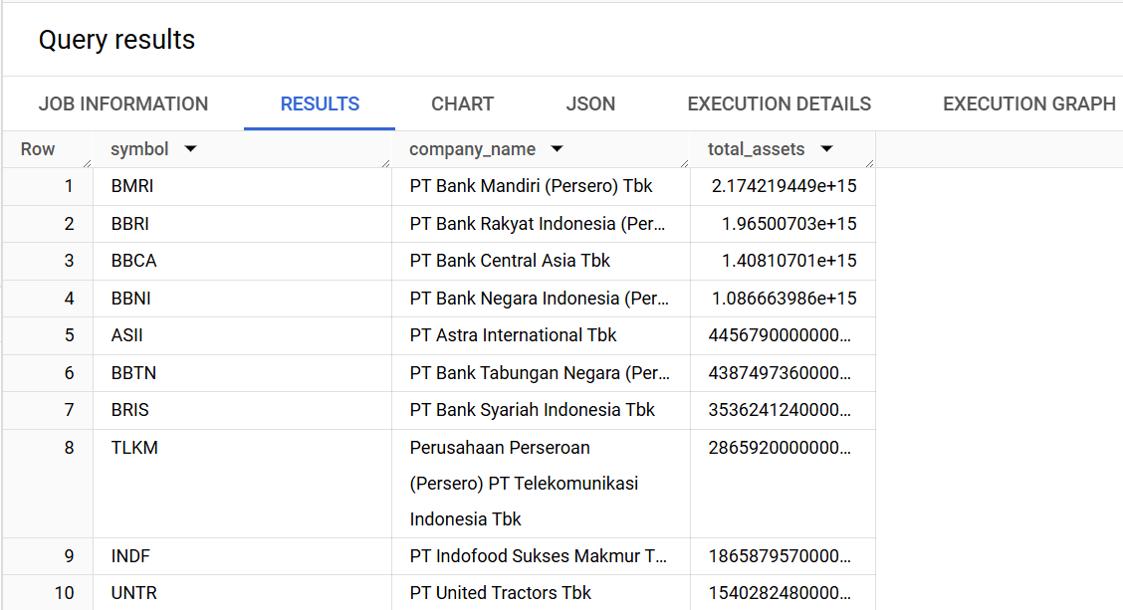

Slide 6
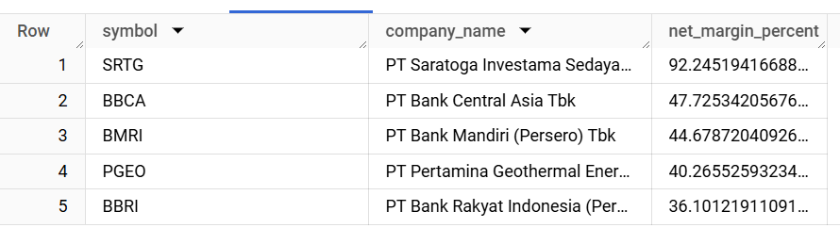

Slide 7
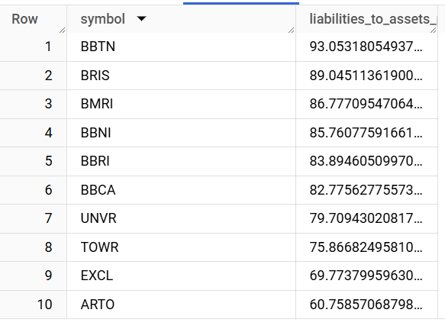

Slide 8
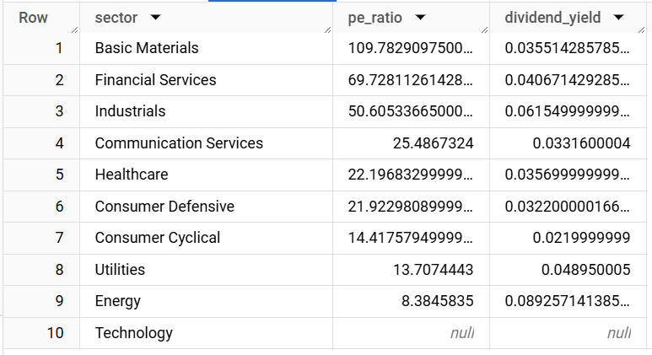

Slide 9
